Slide 1
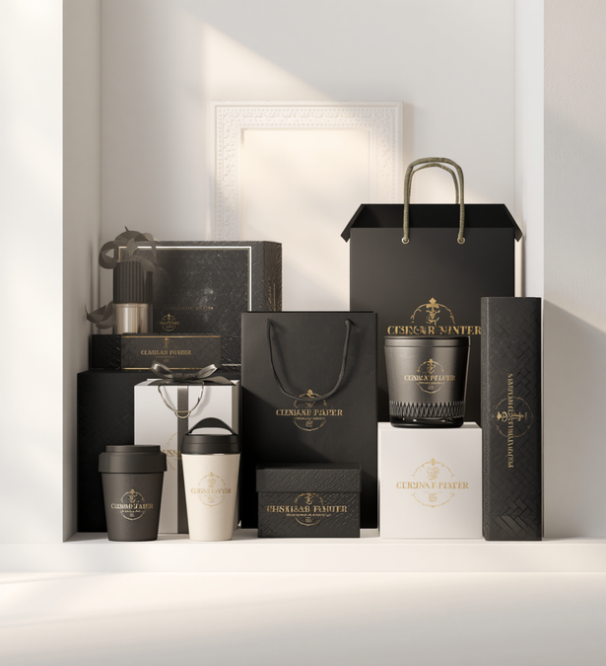
Volume 01
Est. 2024
ORYX Neopack
ORYX Neopack
LUXURY PAPER PACKAGING SOLUTIONS
www.oryxneopack.com

Slide 2
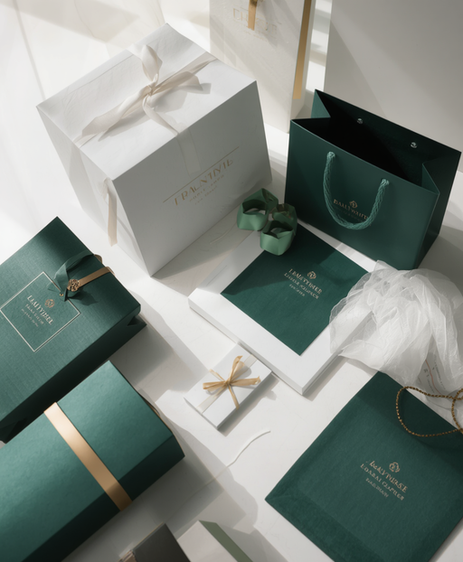
Volume 01
Collection 2023
Who We Are
ORYX Neopack
• Premium paper packaging manufacturer
• Sustainable packaging solutions
• Innovative structural design
• High-quality printing and finishes
• International quality standards
• OEM & Private Label Packaging expertise
ORYX Neopack
www.oryxneopack.com

Slide 3
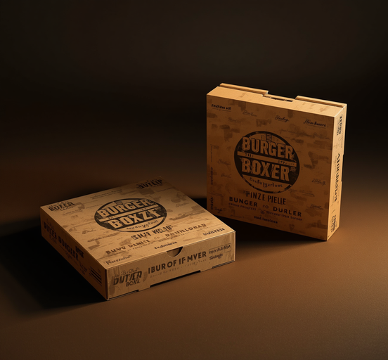
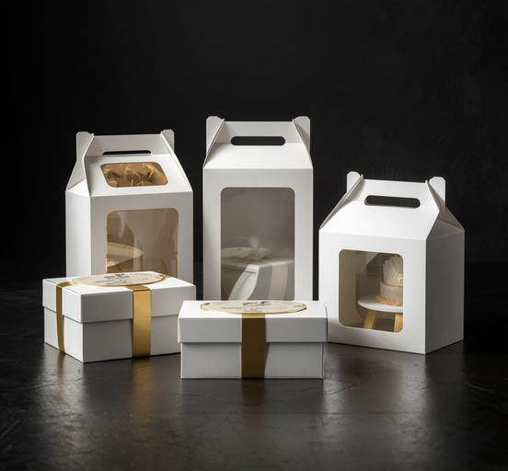
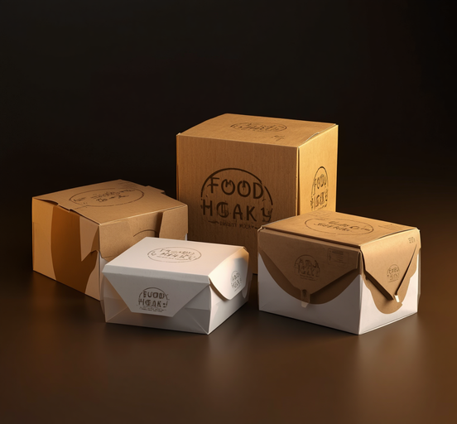
03
ORYX Neopack
Burger & Pizza Boxes
Cake & Bakery Boxes
Takeaway & Meal Boxes
Premium printed paperboard burger and pizza boxes with soft-touch finishes and bold custom branding.
Elegant cake, pastry, and bakery boxes with window cutouts, gold foil accents, and luxury finishes.
Sturdy food-grade takeaway and meal boxes with premium printing, grease resistance, and eco-friendly materials.
ORYX Neopack
www.oryxneopack.com

Slide 4
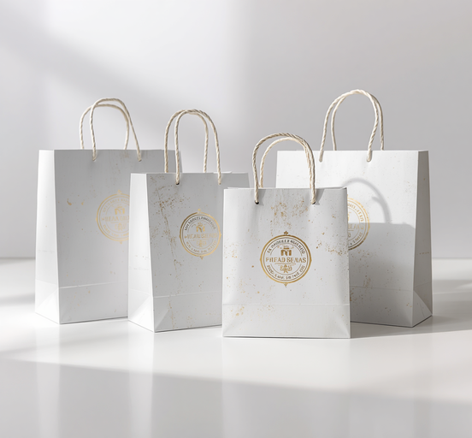

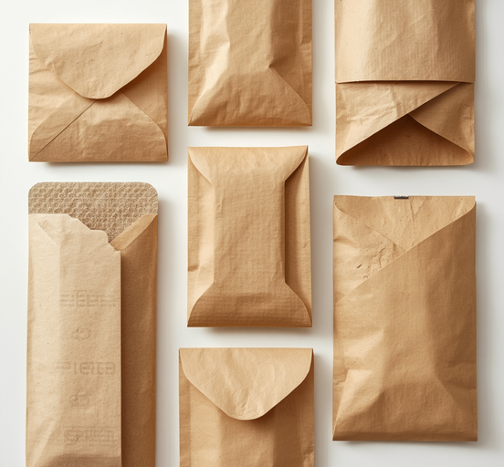
Volume 04
Collection 2023
Shopping Bags
Gift & Rigid Boxes
Paper Sleeves & Kraft
Luxury paper shopping bags with foil stamping, embossing, and premium ribbon handles for high-end retail.
Magnetic rigid boxes, gift boxes, and folding cartons with spot UV, velvet inserts, and bespoke finishes.
Premium kraft and eco-friendly paper sleeves with textured surfaces and sustainable packaging options.
ORYX Neopack
www.oryxneopack.com

Slide 5
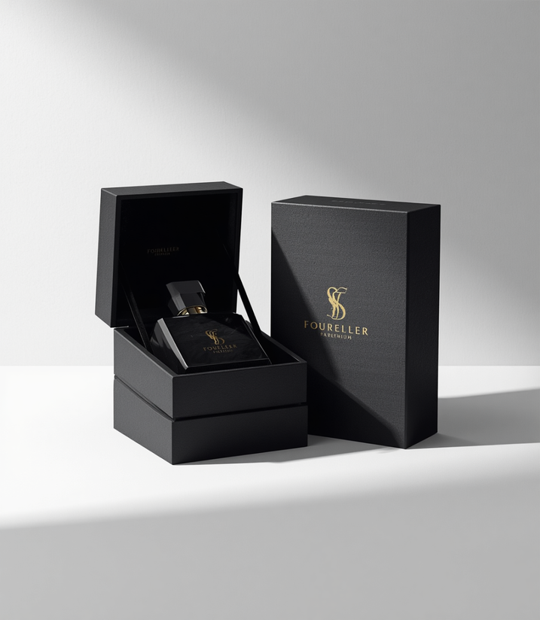
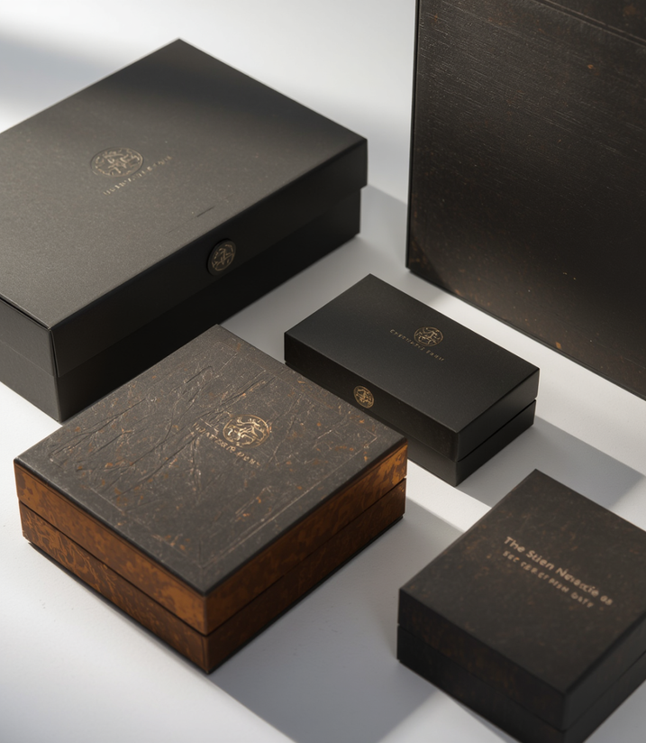
Volume 05
ORYX Neopack
Luxury Perfume
& Cosmetic Boxes
Premium Beauty Packaging
Exquisite perfume boxes, cosmetic packaging, and skincare gift sets crafted with foil stamping, velvet inserts, and magnetic closures — engineered to embody luxury brand standards.
ORYX Neopack
www.oryxneopack.com

Slide 6
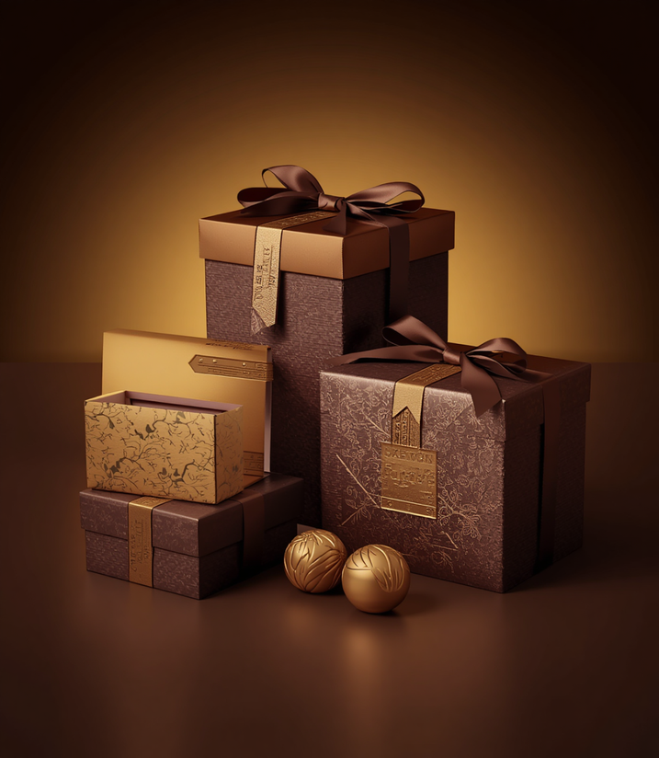
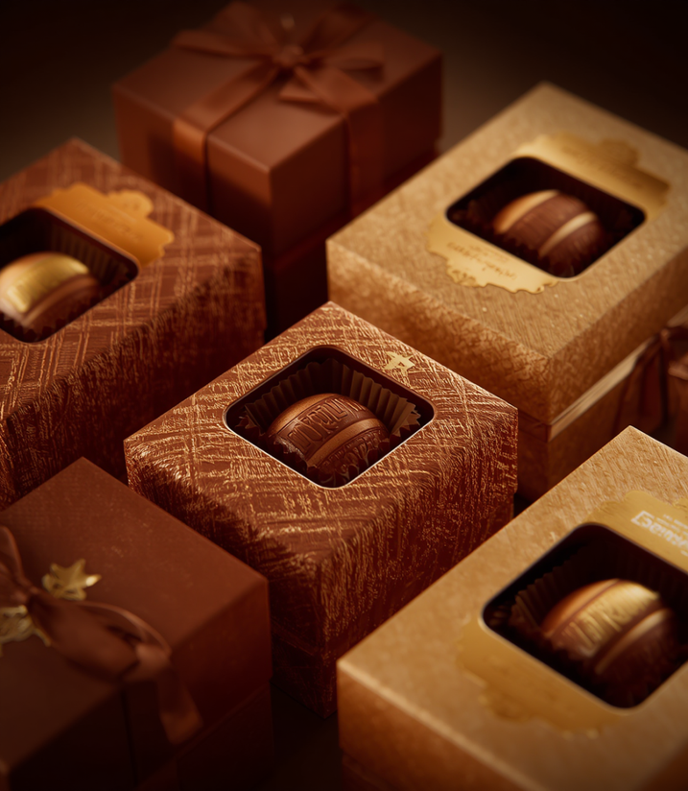
Volume 06
Collection 2023
Premium Chocolate Packaging
Confectionery Collection
Exquisite chocolate gift boxes, sweet boxes, dessert packaging, and candy boxes crafted with gold foil highlights, premium ribbon finishes, and textured paper. Designed to elevate every confectionery experience with richness and elegance.
ORYX Neopack
www.oryxneopack.com

Slide 7
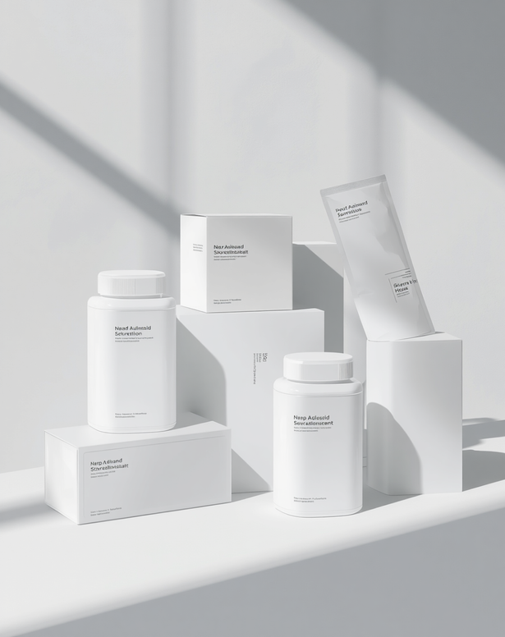
Volume 07
Collection 2025
Pharmaceutical
Packaging
Clinical-Grade Packaging Solutions
Medicine boxes, pharmaceutical cartons, and healthcare product packaging crafted to the highest clinical standards. Our range includes supplement boxes, printed sleeves, and child-safe designs — all featuring crisp finishes, precise printing, and tamper-evident structures that meet international pharmaceutical packaging regulations.
ORYX Neopack
www.oryxneopack.com

Slide 8
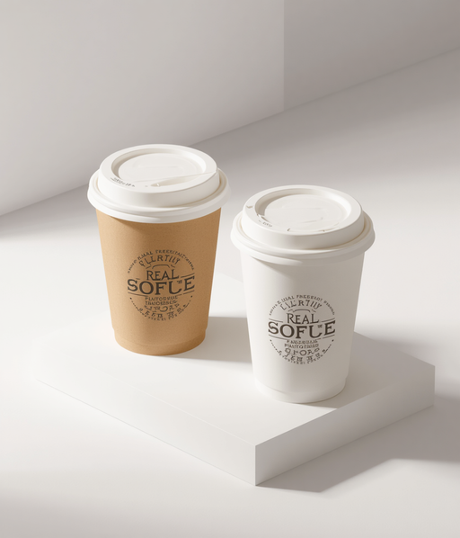
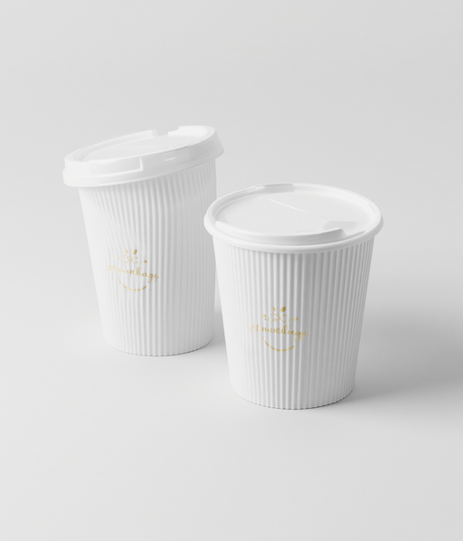
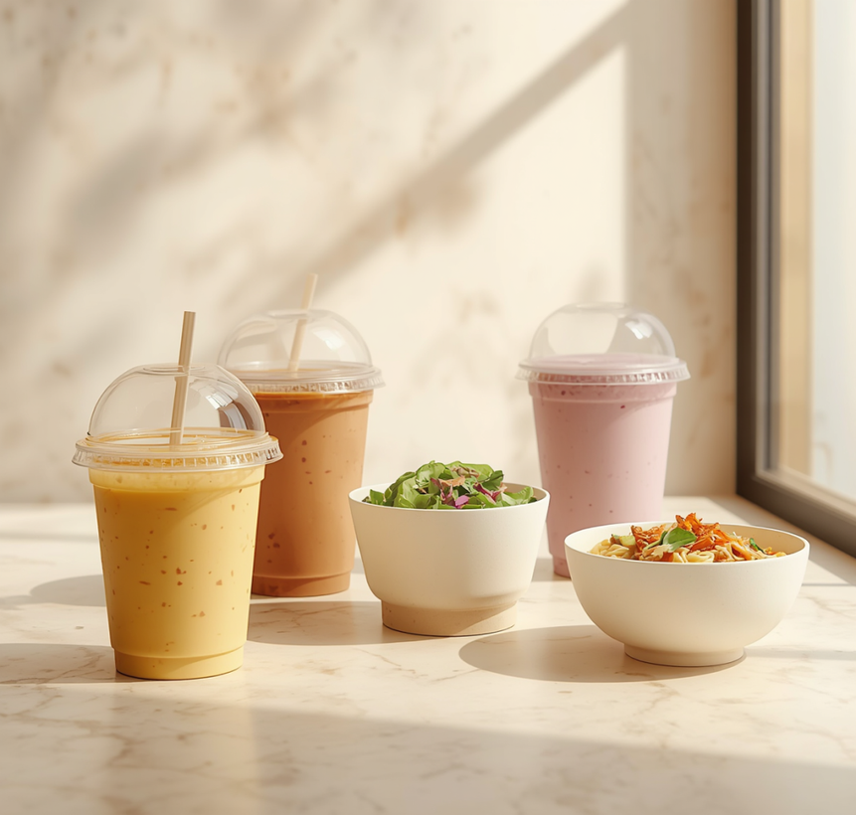
08
ORYX Neopack
From single and double-wall hot cups to ripple cups, ice cream tubs, soup tubs, noodle and salad bowls, and PET cold drink cups — our food service packaging combines premium print quality with functional, sustainable design for upscale coffee shops and restaurants.
ORYX Neopack
www.oryxneopack.com

Slide 9
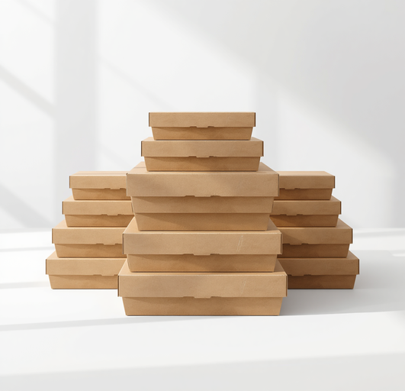
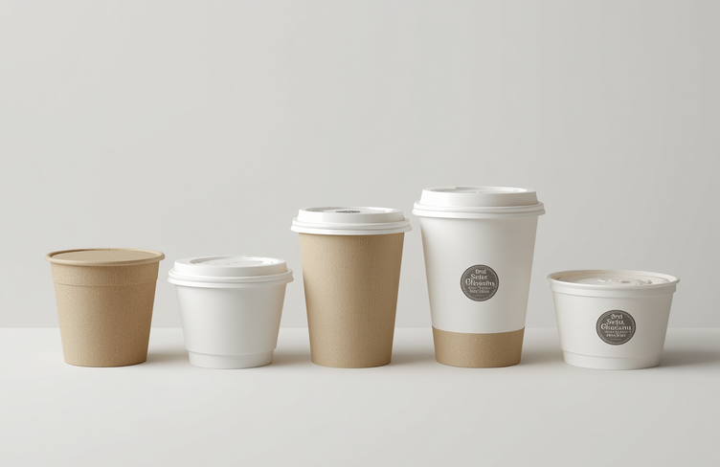
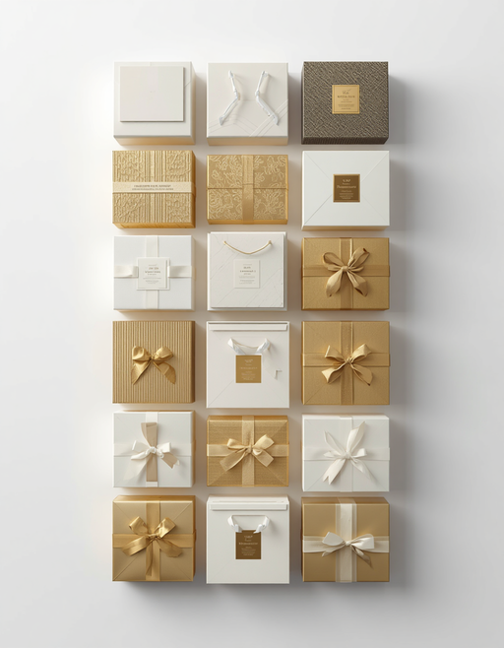
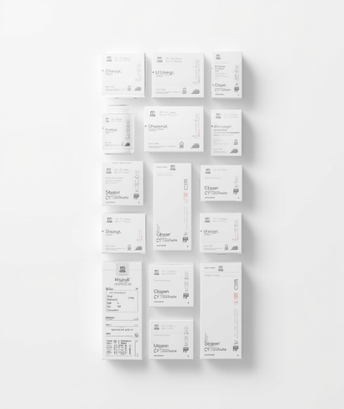
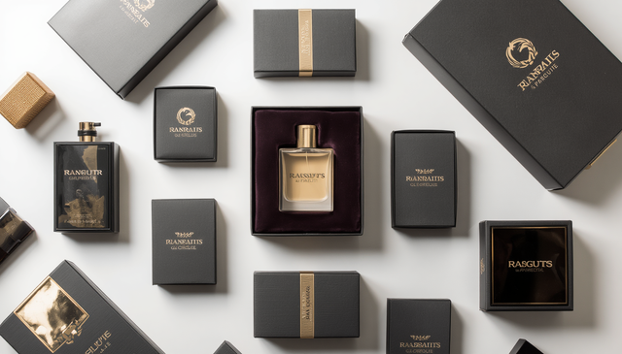

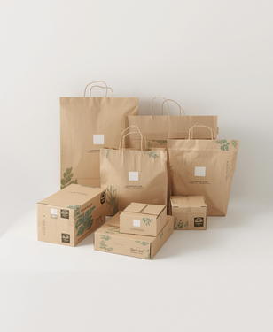
ORYX Neopack
09 / 10
A comprehensive range of premium packaging solutions — from food board and luxury retail to cosmetic, chocolate, pharmaceutical, food service, and sustainable packaging — all crafted to the highest international quality standards.
ORYX Neopack
www.oryxneopack.com

Slide 10
ORYX Neopack
2024
Thank You
Innovative Luxury Packaging Solutions
We craft premium packaging that elevates your brand.
E-mail
info@oryxx.ae
Website
www.oryxxneopack.com
Phone
++971523711855
Address
Dubai , Sharjah , Ajman
ORYX Neopack
www.oryxneopack.com

